Slide 1


Slide 2

5
MONITORING JOBS AND INFLATION
Notes:
Notes and teaching tips: 4, 8, 9, 24, 28, 30, 32, 41, 45, 53, and 57.
To view a full-screen figure during a class, click the expand button.
To return to the previous slide, click the shrink button.
To advance to the next slide, click anywhere on the full screen figure.
Applying the principles of economics to interpret and understand the news is a major goal of the principles course. You can encourage your students in this activity by using the two features: Economics in the News and Economics in Action.
(1) Before each class, scan the news and select two or three headlines that are relevant to your session today. There is always something that works. Read the headline and ask for comments, interpretation, discussion. Pose questions arising from it that motivate today’s class. At the end of the class, return to the questions and answer them with the tools you’ve been explaining.
(2) Once or twice a semester, set an assignment, for credit, with the following instructions:
(a) Find a news article about an economic topic that you find interesting.
(b) Make a short bullet-list summary of the article.
(c) Write and illustrate with appropriate graphs an economic analysis of the key points in the article.
Use the Economics in the News features in your textbook as models.

Slide 3
After studying this chapter, you will be able to:
Explain why unemployment is a problem and how we measure the unemployment rate and other labour market indicators
Explain why unemployment occurs and why it is present even at full employment
Explain why inflation is a problem and how we measure the inflation rate
Copyright © 2019 Pearson Canada Inc.

Slide 4
Employment and Unemployment
What kind of job market will you enter when you graduate?
The class of 2017 had a tough time:
In June 2017, 1.3 million Canadians wanted a job but couldn’t find one and another 700,000 had given up looking for a full-time job and taken a part-time job.
The Canadian economy creates lots of jobs: even in the recession of 2009, 16.8 million Canadians had jobs.
But in recent years, the population has grown faster than the growth of jobs, so unemployment is a persistent problem.
Notes:
Classroom activity
Check out Economics in Action: What Kept Ben Bernanke Awake at Night

Slide 5
Employment and Unemployment
Why Unemployment Is a Problem
Unemployment results in
Lost incomes and production
Lost human capital
The loss of income is devastating for those who bear it. Unemployment benefits create a safety net but don’t fully replace lost wages, and not everyone receives benefits.
Prolonged unemployment permanently damages a person’s job prospects by destroying human capital.

Slide 6
Employment and Unemployment
Labour Force Survey
Every month, Statistics Canada conducts a Labour Force Survey in which it asks 54,000 households.
The population is divided into two groups:
1. The working-age population—the total number of people aged 15 years and over
2. People too young to work (under 15 years of age)

Slide 7
Employment and Unemployment
The working-age population is divided into two groups:
1. People in the labour force
2. People not in the labour force
The labour force is the sum of employed and unemployed workers.

Slide 8
Employment and Unemployment
To be counted as unemployed, a person must be in one of the following three categories:
1. On temporary layoff with an expectation of recall
2. Without work but has made specific efforts to find a job within the previous four weeks
3. Has a new job to start within four weeks
Notes:
Positive versus normative. Unemployment is an emotionally charged subject and is a good one for reinforcing the important point that economics is positive in contrast to normative. The economist’s job is to try to explain why unemployment exists, what determines its rate, and assess the efficient amount of unemployment.
The benefits of unemployment. It comes as a shock to most students that unemployment has benefits as well as costs and that there is an efficient amount of unemployment that is greater than zero. (Note that this statement is positive!) You might like to spend a bit of class time on this topic. If you do, here are some ideas about what to do:
A good way to introduce the idea that unemployment brings benefits is to think about the unemployment of things rather than people. Look around the campus and notice all the unemployed automobiles in the parking lots/stations. Notice the unemployed class rooms early in the morning and late at night. Notice the unemployed coffee shop seats at peak lecture times. Look around the city and notice all the unemployed automobiles in the car sales lots. Try to make a reservation at any of the hotels in the city and notice that you can almost always get a room—hence, lots of unemployed hotel rooms.
[Continued on the note for the next slide.]

Slide 9
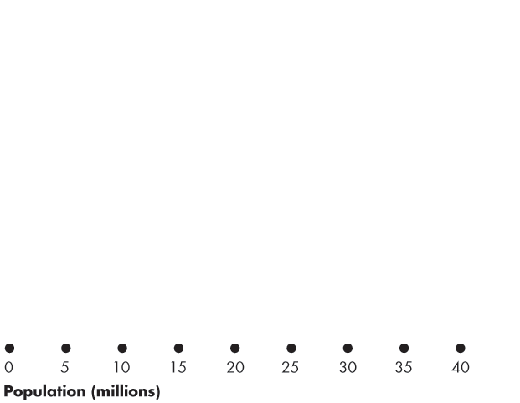
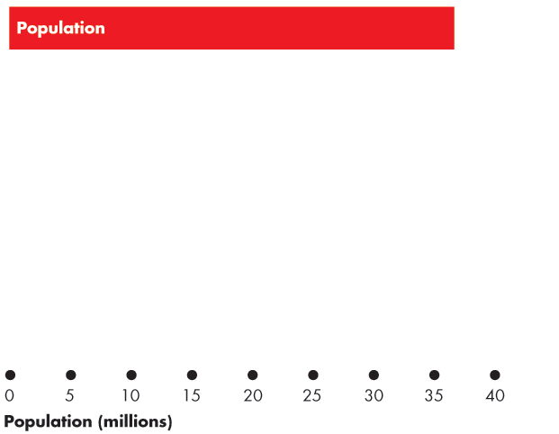
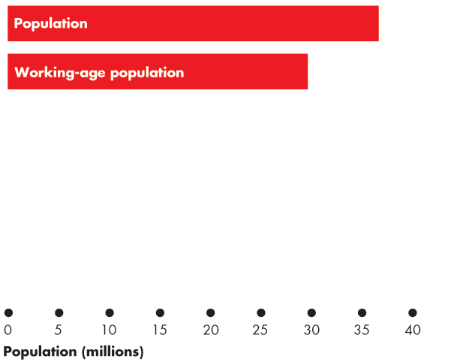
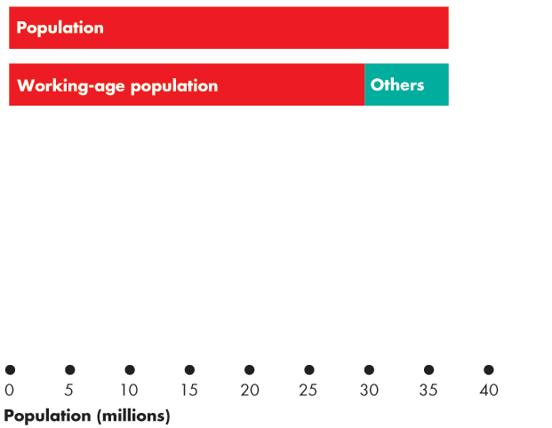
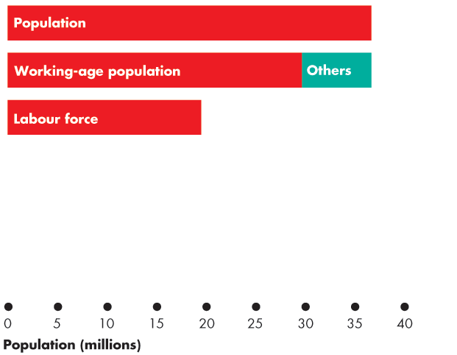
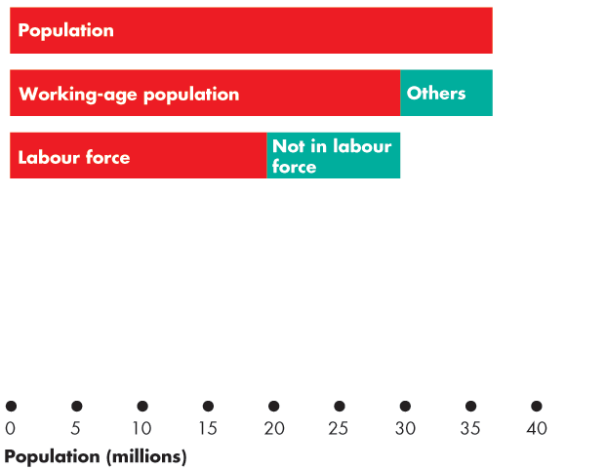
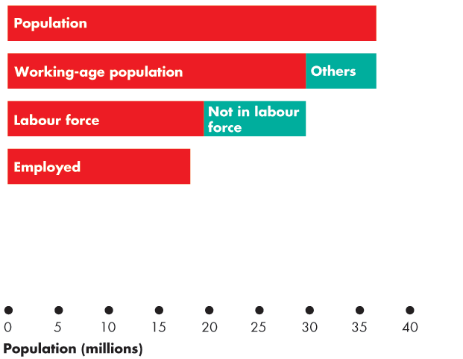
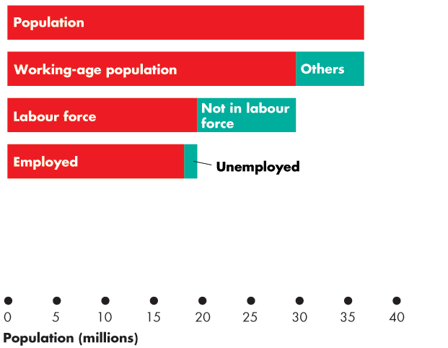

Employment and Unemployment
Figure 5.1 shows the labour force categories.
In 2017:
Population: 36.6 million
Working-age population: 29.88 million
Labour force: 19.68 million
Employment: 18.41 million
Unemployment: 1.27 million
Notes:
Now ask: does all this unemployment bring benefits? The students quickly see that it would be very costly to organize rental markets in which cars don’t sit idle all day, and so on.
Now ask: do the same ideas apply to unemployed people? (Be sure to be compassionate about the misery that unemployment can bring. You are not claiming that it is not costly. You’re trying to identify the benefits, if any.)
You’ll quickly get your students to see that imagining an economy without any unemployment is nearly impossible. If consumers are free to change their decisions about what they want to buy, some goods and services must fall out of favor when others come into favor. The firms making the unfavoured products fall on hard times and often their workers are fired or laid off.
Sure, these laid off workers could start work right away, cleaning shoes or selling flowers at intersections. But they are better off (in their own opinion) being frictionally unemployed and searching for new jobs. To eliminate this source of unemployment we would need to forbid consumers from changing their buying plans or insist that no one remain idle and get on with doing any job even if it doesn’t earn a wage.
Note that if this is how we ran our economy, we’d still be using coal-fired stoves and the pony express, and we’d be wearing coonskin caps. There would be no McDonald’s, Federal Express, or Nike shoes.

Slide 10
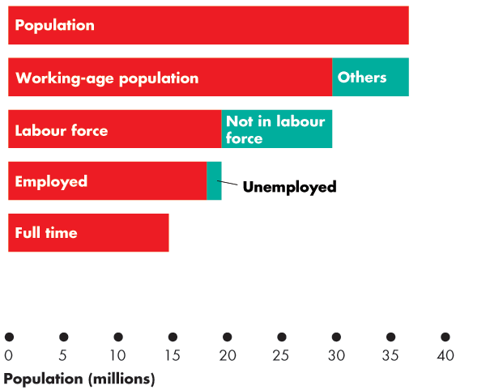
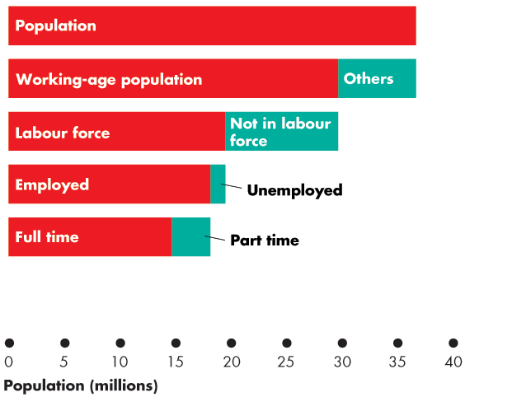
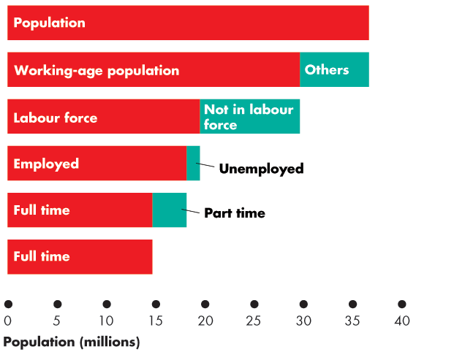
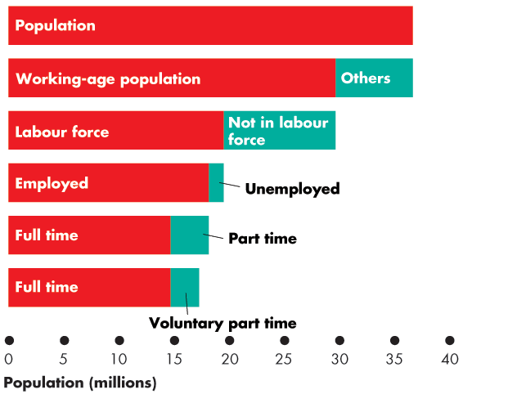
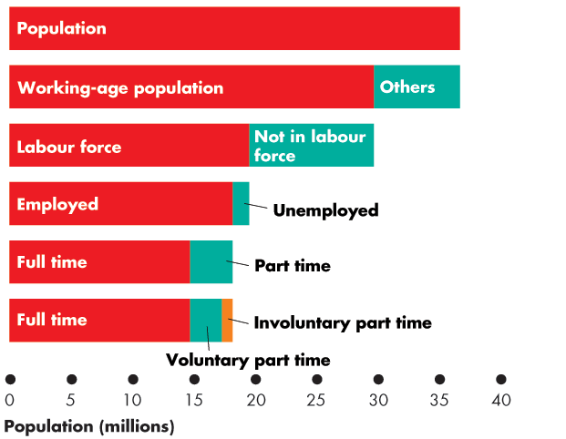

Slide 11
Employment and Unemployment
Full-time employment: 14.87 million
Part time: 3.54 million
Voluntary part time: 2.67 million
Involuntary part time: 0.87 million

Slide 12
Employment and Unemployment
Four Labour Market Indicators
The unemployment rate
Involuntary part-time rate
The labour force participation rate
The employment rate

Slide 13
Employment and Unemployment
The Unemployment Rate
The unemployment rate is the percentage of the labour force that is unemployed.
The unemployment rate is (Number of people unemployed ÷ labour force) × 100.
In 2017, the labour force was 19.68 million and 1.27 million were unemployed, so the unemployment rate was 6.5 percent.
The unemployment rate increases in a recession and reaches its peak value after the recession ends.

Slide 14
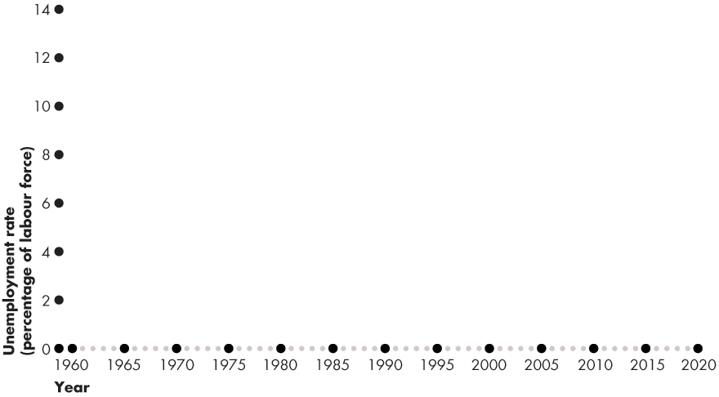
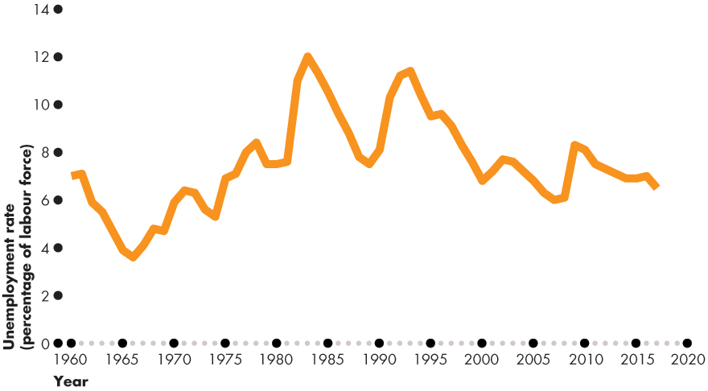
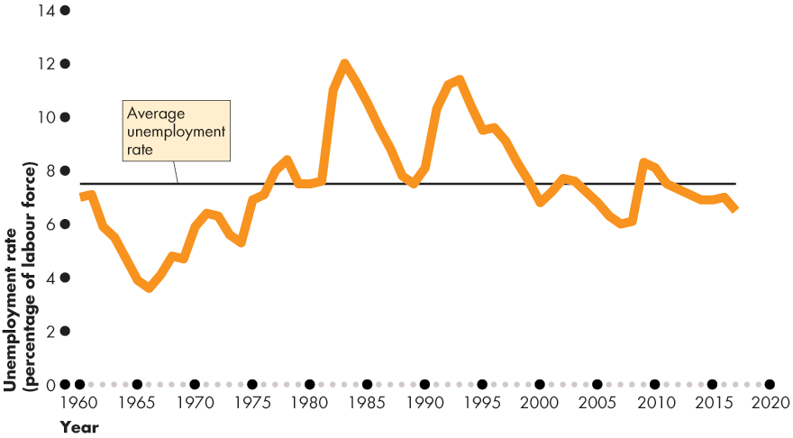
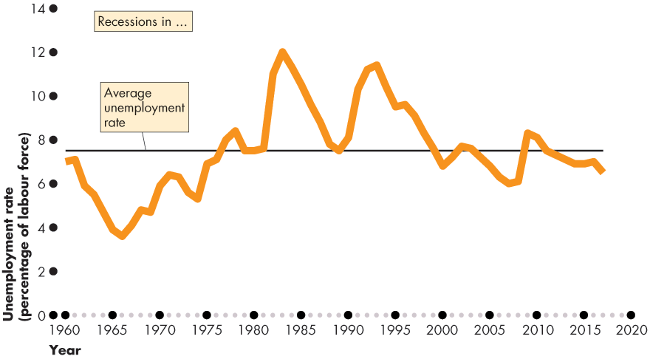

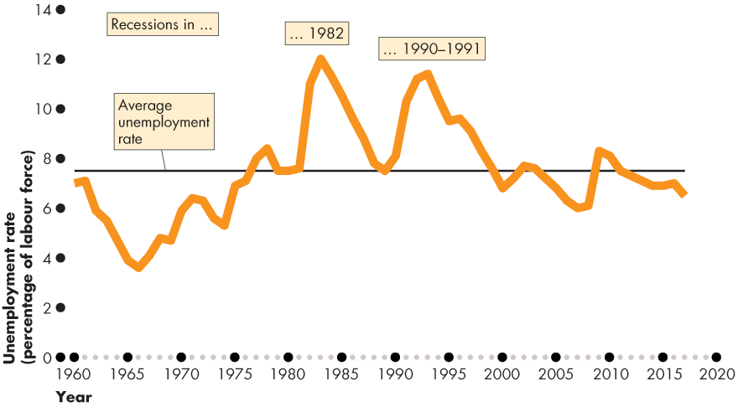

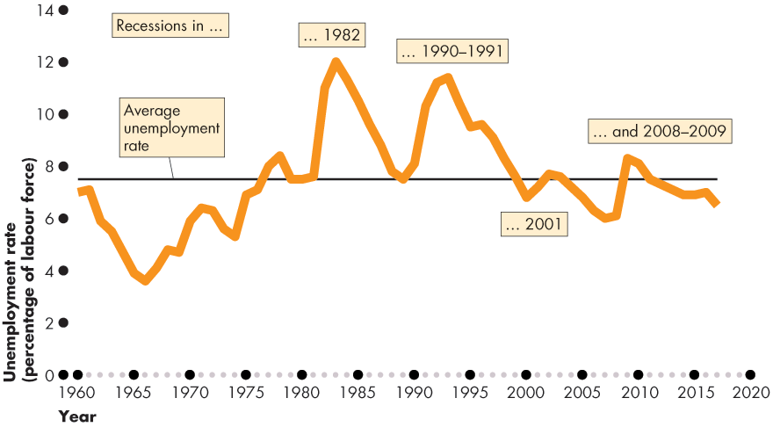

Employment and Unemployment
Figure 5.2 shows the unemployment rate: 1960–2017.
The unemployment rate increases in a recession.

Slide 16
Employment and Unemployment
The Involuntary Part-Time Rate
The involuntary part-time rate is the percentage of the labour force who work part time but want full-time jobs.
The involuntary part-time rate is (Number of involuntary part-time workers ÷ Labour force) × 100.
In 2017 the 865,400 involuntary part-time workers and the labour force was 19.68 million.
The involuntary part-time rate 4.4 percent.

Slide 17
Employment and Unemployment
The Labour Force Participation Rate
The labour force participation rate is the percentage of the working-age population who are members of the labour force.
The labour force participation rate is (Labour force ÷ Working-age population) × 100.
In 2017, the labour force was 19.68 million and the working-age population was 29.88 million.
The labour force participation rate was 65.9 percent.

Slide 18
Employment and Unemployment
The Employment Rate
The employment rate is the percentage of the working-age population who have jobs.
The employment rate is (Employment ÷ Working-age population) × 100.
In 2017, the number of people employed was 18.41 million and the working-age population was 29.88 million.
The employment rate was 61.6 percent.

Slide 19
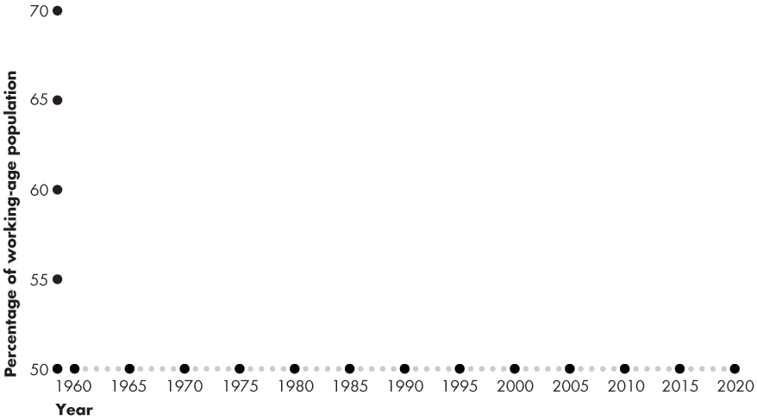
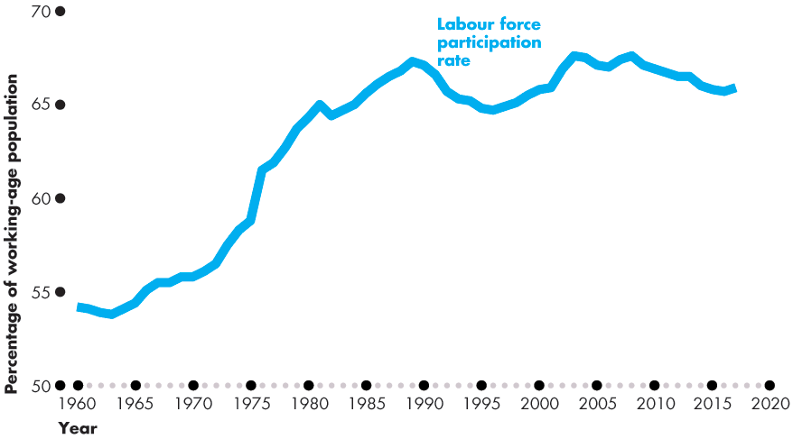
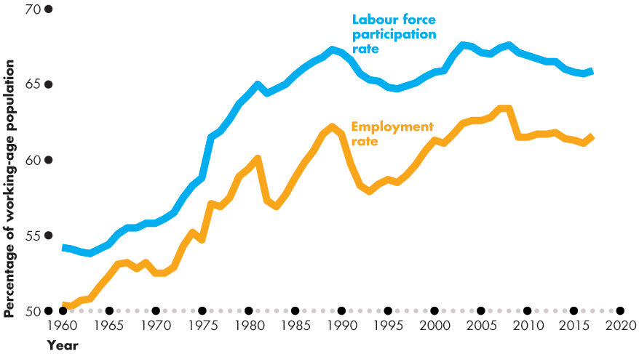
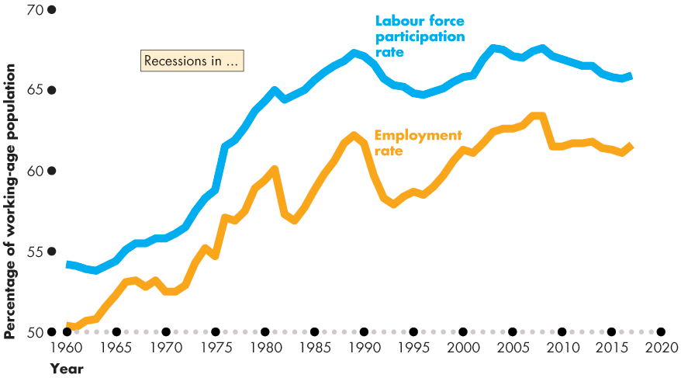
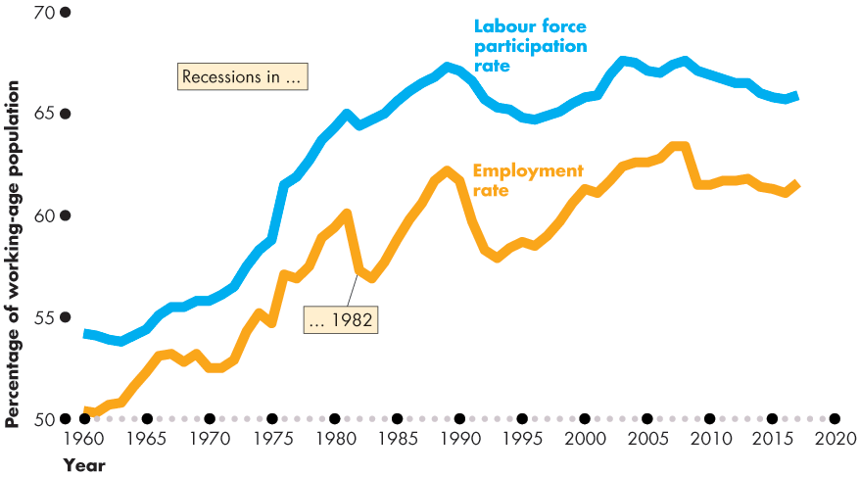
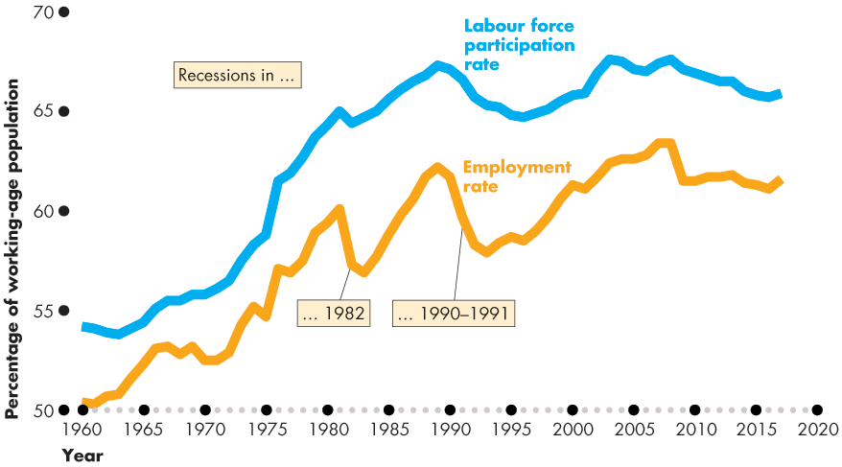
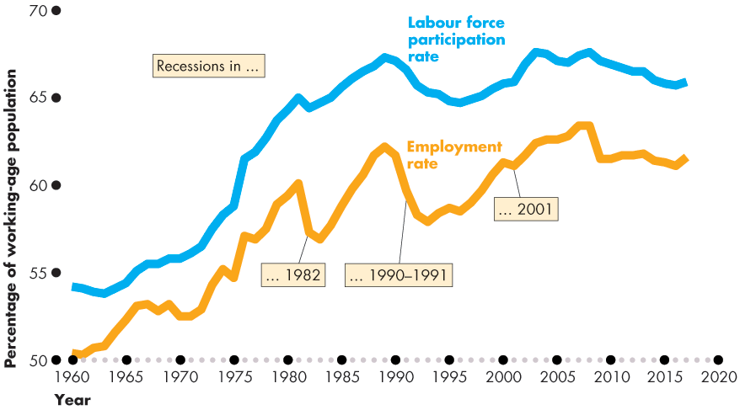
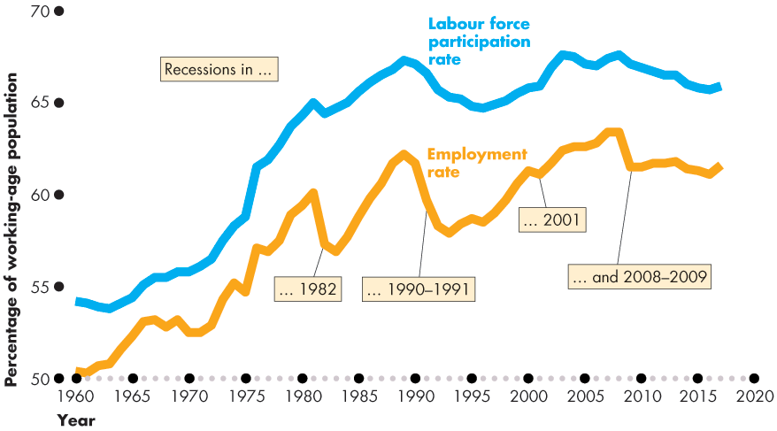

Employment and Unemployment
Figure 5.3 shows the labour force participation rate and employment rate.
Both increased rapidly before 1990 and slowly after 1990.

Slide 21
Employment and Unemployment
Other Definitions of Unemployment
The purpose of the unemployment rate is to measure the underutilization of labour resources.
Statistics Canada believes that the unemployment rate gives a correct measure.
But the official measure is an imperfect measure because it excludes
Discouraged searchers
Long-term future starts
Involuntary part-timers

Slide 22
Employment and Unemployment
Discouraged Searchers
A discouraged searcher is a person who currently is neither working nor looking for work but has indicated that he or she wants and is available for a job and has looked for work sometime in the recent past but has stopped looking because of repeated failure.
Long-Term Future Starts
A person with a job to start in more than four weeks is not counted as unemployed.

Slide 23
Employment and Unemployment
Part-Time Workers Who Want Full-Time Jobs
Part-time workers who want full-time jobs and can’t find them as not counted as unemployed.
Most Costly Unemployment
All unemployment is costly, but the most costly is long-term unemployment that results from job loss.

Slide 24
Employment and Unemployment
Alternative Measures of Unemployment
Statistics Canada reports eight alternative measures of the unemployment rate: three narrower than the official measure and four broader ones.
The narrower measures, R-1 and R-2, focus on the personal cost of unemployment.
R-4 is the official unemployment rate; R-3 is comparable to the U.S. rate.
The broader measures, R-4, R-5, and R-6, focus on assessing the full amount of underemployed labour resources.
Notes:
Classroom activity
Check out Economics in the News: Comparing Jobs Growth in Canada and the United States

Slide 25
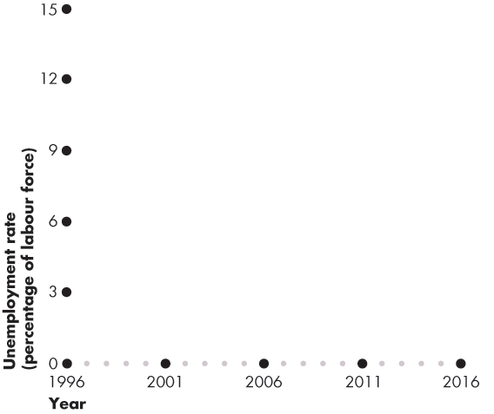
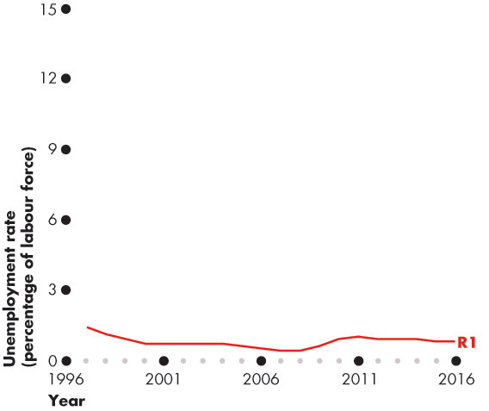
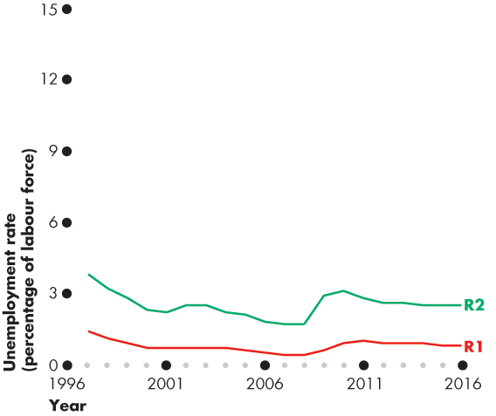
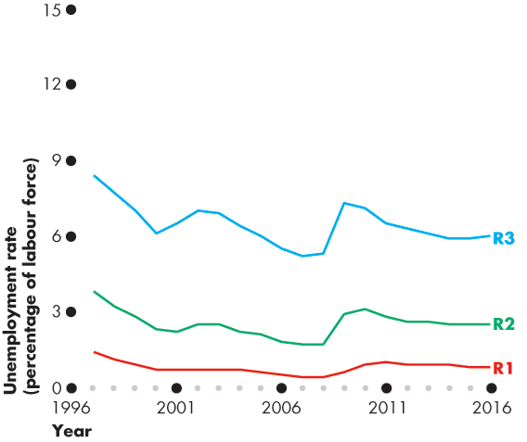
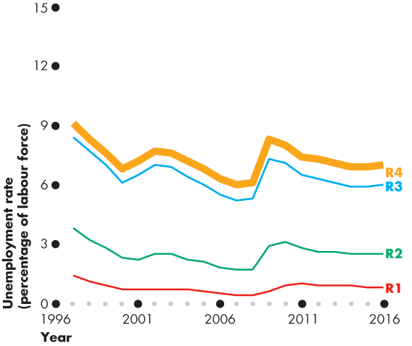

Employment and Unemployment
Figure 5.4 shows eight alternative measures.
R-1: Long-term unemployed (15 or more weeks)
R-2: Short-term unemployed
R-3: The unemployment rate comparable to the U.S. rate
R-4: The official unemployment rate

Slide 26
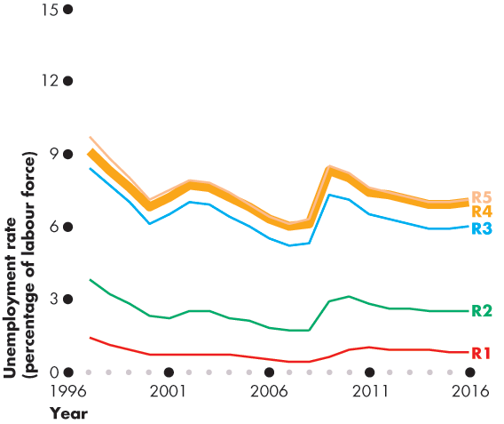
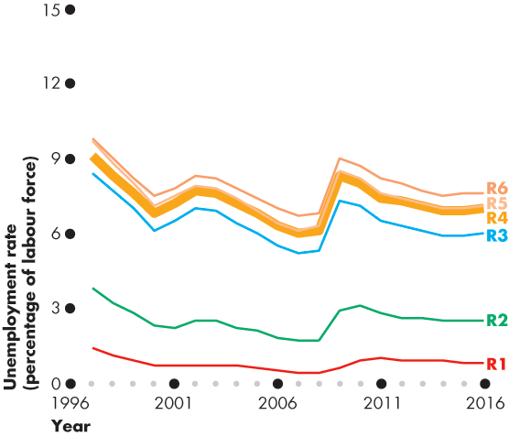
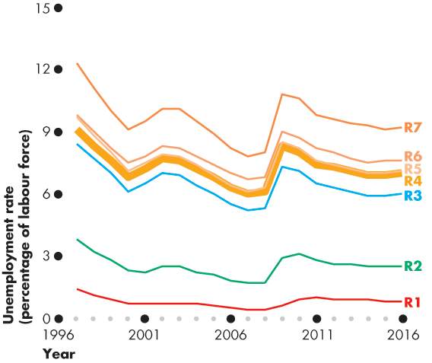
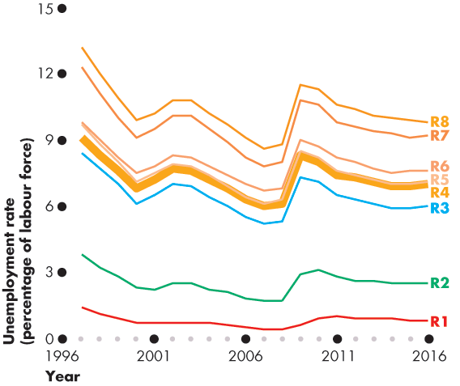
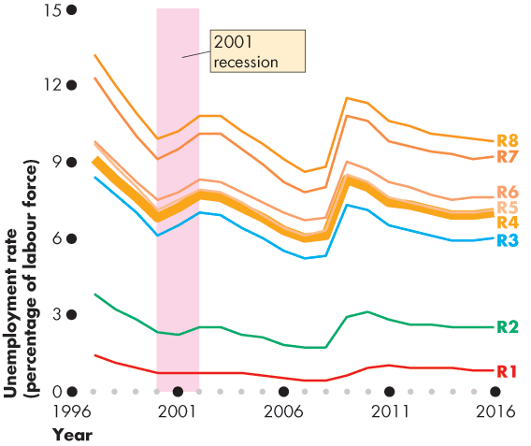
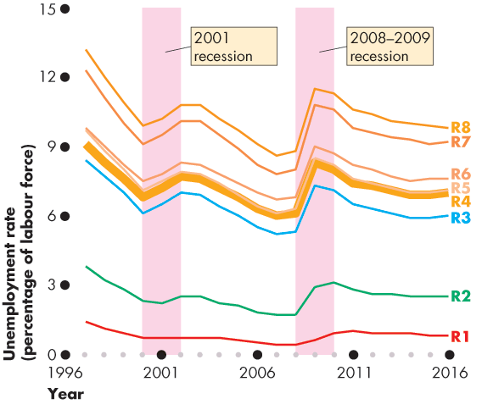

Slide 27
Employment and Unemployment
Broader measures are
U-5: U-4 + Discouraged searchers
U-6: U-5 + Long-term future starts
U-7: U-6 + involuntary part-timers
U-8: total underemployment
All measures increase together in recession.

Slide 28
Unemployment and Full Employment
Unemployment can be classified into three types:
Frictional unemployment
Structural unemployment
Cyclical unemployment
Notes:
Identifying frictional, structural, and cyclical unemployment. Ask your class if anyone they know has been laid off. Then discuss whether losing a job creates frictional, structural, or cyclical unemployment. Look at your local examples. If you live in a steel-producing area, for example, you can talk about local structural unemployment arising from the closing of a steel manufacturer due to international competition. For cyclical unemployment, ask students how they think the business cycle and cyclical unemployment is related to full-time enrollments at higher education institutions. Students often don’t think there is any relationship. But nationally during a recession, the growth rate of full-time enrollments increases. Ask students if they can explain this relationship. The answer is that during a recession and due to the increase in cyclical unemployment, the opportunity cost of school decreases. This is a great way to keep students thinking about marginal benefits and costs.

Slide 29
Unemployment and Full Employment
Frictional Unemployment
Frictional unemployment is unemployment that arises from normal labour market turnover.
The creation and destruction of jobs requires that unemployed workers search for new jobs.
Increases in the number of people entering and reentering the labour force and increases in unemployment benefits raise frictional unemployment.
Frictional unemployment is a permanent and healthy phenomenon of a growing economy.

Slide 30
Unemployment and Full Employment
Structural Unemployment
Structural unemployment is unemployment created by changes in technology and foreign competition that change the skills needed to perform jobs or the locations of jobs.
Structural unemployment lasts longer than frictional unemployment.
Notes:
Classroom activity
Check out Economics in Action: Structural Unemployment in Canada

Slide 31
Unemployment and Full Employment
Cyclical Unemployment
Cyclical unemployment is the higher than normal unemployment at a business cycle trough and lower than normal unemployment at a business cycle peak.
A worker laid off because the economy is in a recession and is then rehired when the expansion begins experiences cycle unemployment.

Slide 32
Unemployment and Full Employment
“Natural” Unemployment
Natural unemployment is the unemployment that arises from frictions and structural change when there is no cyclical unemployment.
Natural unemployment is all frictional and structural unemployment.
The natural unemployment rate is natural unemployment as a percentage of labour force.

Slide 33
Unemployment and Full Employment
Full employment is defines as the situation in which the unemployment rate equals the natural unemployment rate.
When the economy is at full employment, there is no cyclical unemployment or, equivalently, all unemployment is frictional and structural.

Slide 34
Unemployment and Full Employment
The natural unemployment rate changes over time and is influenced by many factors.
Key factors are
The age distribution of the population
The scale of structural change
The real wage rate
Unemployment benefits

Slide 35
Unemployment and Full Employment
Real GDP and Unemployment Over the Cycle
Potential GDP is the quantity of real GDP produced at full employment.
Potential GDP corresponds to the capacity of the economy to produce output on a sustained basis.
Real GDP minus potential GDP is the output gap.
Over the business cycle, the output gap fluctuates and the unemployment rate fluctuates around the natural unemployment rate.

Slide 36
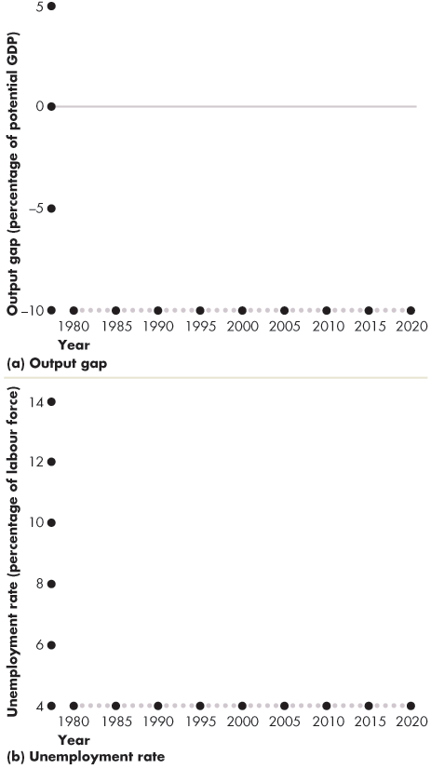
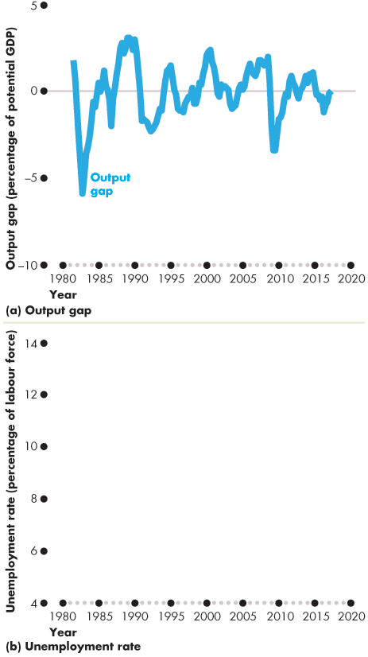
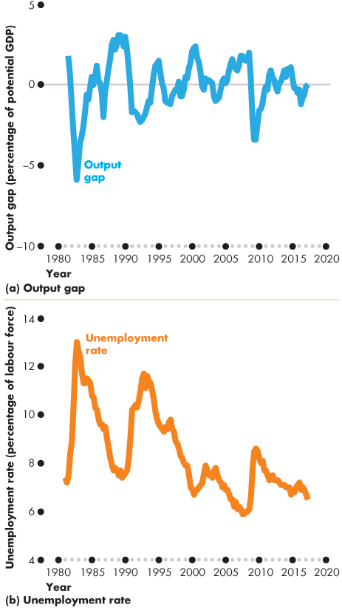
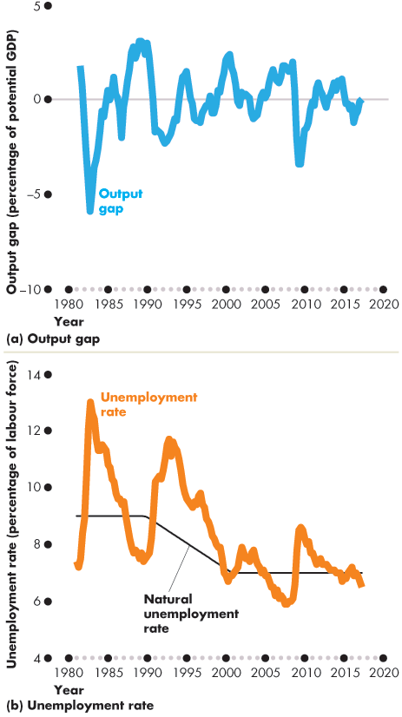
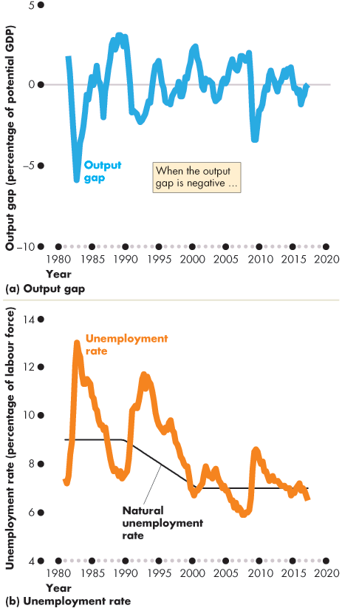
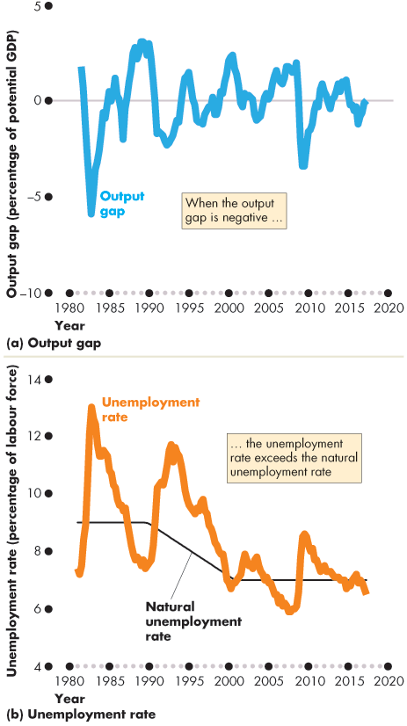
Unemployment and Full Employment
Figure 5.5 shows the output gap and …
the fluctuations of unemployment around the natural rate.
When the output gap is negative, unemployment exceeds the natural unemployment rate.

Slide 38
Price Level, Inflation, and Deflation
The price level is the average level of prices and the value of money.
A persistently rising price level is called inflation.
A persistently falling price level is called deflation.
We are interested in the price level because we want to
1. Measure the inflation rate or the deflation rate
2. Distinguish between money values and real values of economic variables.

Slide 39
Price Level, Inflation, and Deflation
Why Inflation and Deflation Are Problems
Low, steady, and anticipated inflation or deflation is not a problem.
Unpredictable inflation or deflation is a problem because it
Redistributes income and wealth
Lowers real GDP and employment
Diverts resources from production

Slide 40
Price Level, Inflation, and Deflation
Unpredictable changes in the inflation rate redistribute income in arbitrary ways between employers and workers and between borrowers and lenders.
A high inflation rate is a problem because it diverts resources from productive activities to inflation forecasting.
From a social perspective, this waste of resources is a cost of inflation.
At its worse, inflation becomes hyperinflation—an inflation rate that is so rapid that workers are paid twice a day because money loses its value so quickly.

Slide 41
Price Level, Inflation, and Deflation
The Consumer Price Index
The Consumer Price Index, or CPI, measures the average of the prices paid by urban consumers for a “fixed” basket of consumer goods and services.
Notes:
The CPI—an average. It is important for students to understand that the CPI is based on the average expenditure basket, not the expenditure pattern of any given household. Displaying the detailed press releases on the BLS Web site helps make this point very forcibly: students often do not realize until they see the numbers that the CPI must include both costs of owning a house and costs of renting one; costs of buying a car and costs of public transportation; and so on.

Slide 42
Price Level, Inflation, and Deflation
Reading the CPI Numbers
The CPI is defined to equal 100 for the reference base period.
Currently, the reference base period is 2002.
That is, for the average CPI of the 12 months of 2002 equals 100.
In June 2017, the CPI was 130.4.
This number tells us that the average of the prices paid by urban consumers for a fixed basket of goods was 30.4 percent higher in June 2017 than it was during 2002.

Slide 43
Price Level, Inflation, and Deflation
Constructing the CPI
Constructing the CPI involves three stages:
Selecting the CPI basket
Conducting a monthly price survey
Calculating the CPI

Slide 44
Price Level, Inflation, and Deflation
The CPI Basket
The CPI basket is based on a consumer expenditure survey conducted by Statistics Canada, which is undertaken infrequently.
Today’s CPI basket today is based on data collected in the Consumer Expenditure Survey of 2015 and valued at prices in January 2017.

Slide 45
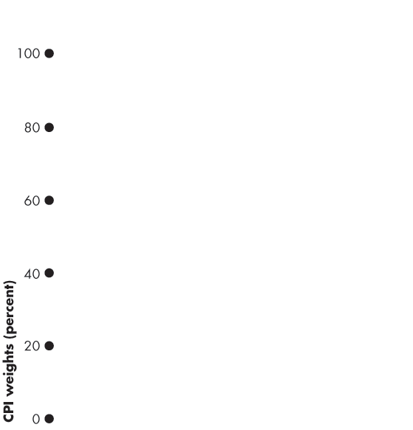
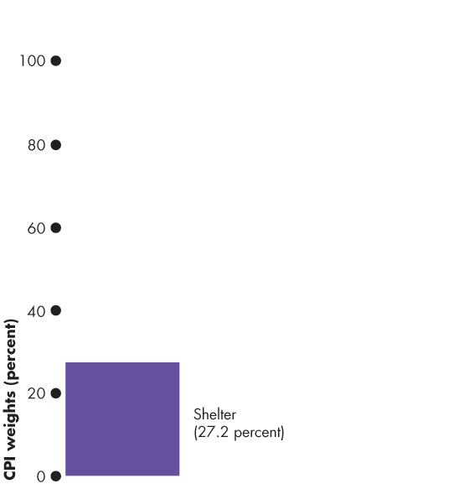
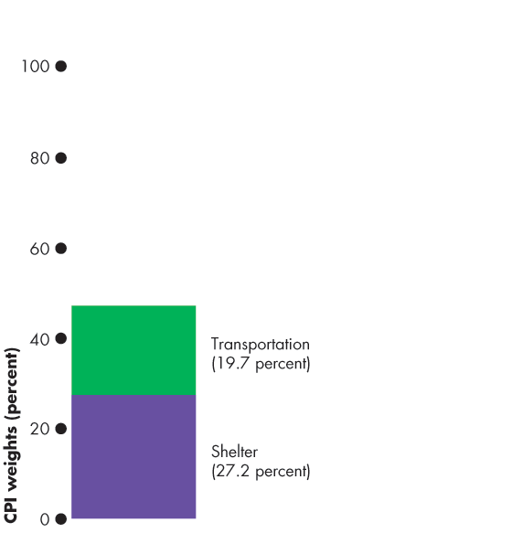
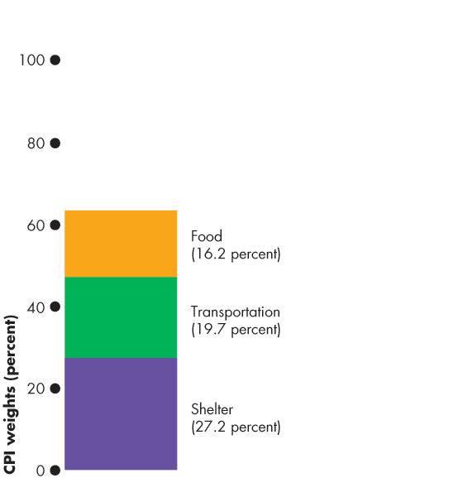
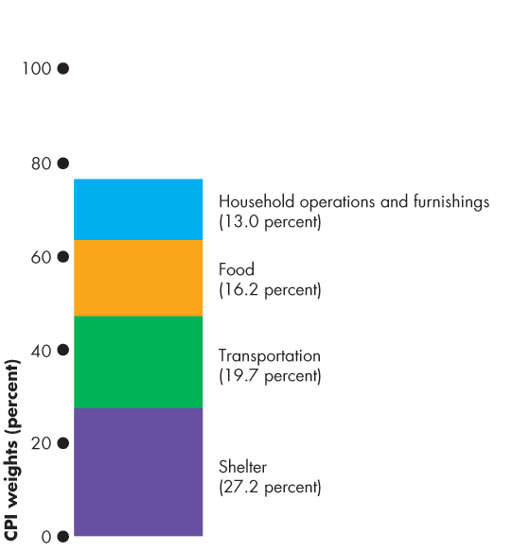
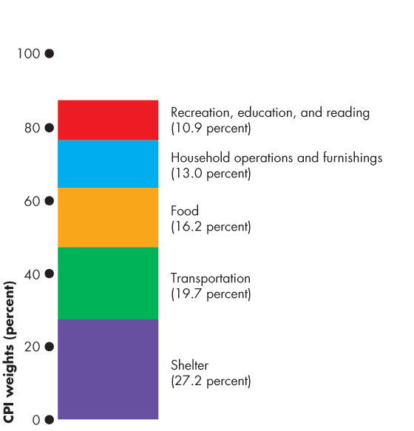



Price Level, Inflation, and Deflation
Figure 5.6 illustrates the CPI basket.
Shelter is the largest component.
Transportation and food and beverages are the next largest components.
The remaining components account for 37 percent of the basket.
Notes:
Making the CPI personal. If you have time (or want to make time) you can get your students to construct their own CPI basket. Each student makes a statement of her/his expenditure in the same categories as the CPI basket in the figure on this slide. Students then compare their expenditure patterns to the average of the CPI basket.

Slide 47
Price Level, Inflation, and Deflation
The Monthly Price Survey
Every month, Statistics Canada employees check the prices of the goods and services in the CPI basket in the major cities.
Calculating the CPI
1. Find the cost of the CPI basket at base-period prices.
2. Find the cost of the CPI basket at current-period prices.
3. Calculate the CPI for the current period.

Slide 48





Price Level, Inflation, and Deflation
Let’s work an example of the CPI calculation.
In a simple economy, people consume only oranges and haircuts.
The CPI basket is 10 oranges and 5 haircuts.
The table also shows the prices in the base period.
The cost of the CPI basket in the base period was $50.

Slide 49


Slide 50



Price Level, Inflation, and Deflation
Table 5.1(b) shows the fixed CPI basket of goods.
It also shows the prices in the current period.
The cost of the CPI basket at current-period prices is $70.

Slide 51
Price Level, Inflation, and Deflation
The CPI is calculated using the formula:
CPI = (Cost of basket at current-period prices ÷ Cost of basket at base-period prices) × 100.
Using the numbers for the simple example,
CPI = ($70 ÷ $50) × 100 = 140.
The CPI is 40 percent higher in the current period than it was in the base period.

Slide 52
Price Level, Inflation, and Deflation
Measuring the Inflation Rate
The major purpose of the CPI is to measure inflation.
The inflation rate is the percentage change in the price level from one year to the next.
The inflation rate equals:
[(CPI this year – CPI last year) ÷ CPI last year] × 100.

Slide 53


Price Level, Inflation, and Deflation
Figure 5.7 shows the relationship between the price level and the inflation rate.
Figure 5.7(a) shows the CPI from 1970 to 2017.

Slide 54







Slide 55


Price Level, Inflation, and Deflation
Figure 5.7(b) shows that the inflation rate is:
High when the price level is rising rapidly

Slide 56


Price Level, Inflation, and Deflation
Low when the price level is rising slowly
Negative when the price level is falling

Slide 57
Price Level, Inflation, and Deflation
The Biased CPI
The CPI might overstate the true inflation for four reasons:
New goods bias
Quality change bias
Commodity substitution bias
Outlet substitution bias
Notes:
CPI biases—concrete illustrations. New goods bias can be illustrated with MP3 music rather than CDs; quality change with computers and cars; commodity substitution with movies versus videos; and outlet substitution by the growth of Wal-mart, Target, and shopping on the internet.

Slide 58
Price Level, Inflation, and Deflation
New Goods Bias
New goods that were not available in the base year appear and, if they are more expensive than the goods they replace, they put an upward bias into the CPI.
Quality Change Bias
Quality improvements occur every year. Part of the rise in the price is payment for improved quality and is not inflation.
The CPI counts all the price rise as inflation.

Slide 59
Price Level, Inflation, and Deflation
Commodity Substitution Bias
The market basket of goods used in calculating the CPI is fixed and does not take into account consumers’ substitutions away from goods whose relative prices increase.
Outlet Substitution Bias
As the structure of retailing changes, people switch to buying from cheaper sources, but the CPI, as measured, does not take account of this outlet substitution.

Slide 60
Price Level, Inflation, and Deflation
The Magnitude of the Bias
Estimates say that the CPI overstates inflation by 0.6 percentage points a year.
Some Consequences of the Bias
Distorts private contracts.
Increases government outlays (close to a third of federal government outlays are linked to the CPI).
A bias of 0.6 percent is small, but over a decade adds up to billions of dollars of additional expenditure.

Slide 61
Price Level, Inflation, and Deflation
Alternative Price Indexes
Alternative measures of the price level are
GDP deflator
Chained price index for consumption (CPIP)

Slide 62
Price Level, Inflation, and Deflation
GDP Deflator
The GDP deflator equals
(Nominal GDP ÷ Real GDP) × 100
GDP deflator is a broader measure of the price level than the CPI because it includes all final expenditure on Canadian produced goods and services.
But as a cost of living, the GDP deflator is too broad.
Over the period 2000 to 2016, the GDP deflator increased at an average rate of 1.9 percent a year, which is 0.3 percentage points below the CPI inflation rate.

Slide 63
Price Level, Inflation, and Deflation
Chained Price Index for Consumption
CPIC = (Nominal consumption expenditure ÷ Real consumption expenditure) × 100
Because the GDP deflator and CPIC use current-period and previous-period quantities, they and incorporate substitution effects and new goods and overcome the sources of bias in the CPI.
From 2000 to 2016, CPIC increased at an average rate of 1.8 percent a year, which is 0.4 percentage points below the CPI inflation rate.

Slide 64
Price Level, Inflation, and Deflation
Core Inflation Rate
The core inflation rate excludes the volatile prices of the CPI basket in an attempt to reveal the inflation trend.
The Bank of Canada monitors three measures:
The CPI-trim is the CPI excluding the top and bottom 20 percent most extreme price changes.
The CPI-median measures inflation as the percentage change in the middle items in the CPI basket.
The CPI-common uses a statistical method to reveal the most common price changes.

Slide 65



Price Level, Inflation, and Deflation
The Bank of Canada uses the CPI-trim measure as its measure of core inflation.
The core inflation rate removes most of the wide swings in the CPI inflation rate.

Slide 67
Price Level, Inflation, and Deflation
The Real Variables in Macroeconomics
We can use the GPD deflator to deflate nominal variables to find their real values.
For example,
Real wage rate = (Nominal wage rate ÷ GDP deflator) ×100
But not the real interest rate! It is different.

